Slide 1
ARDC Control of IPMSM for Treadmill Application
-By Laukik Desai

Slide 2
Index
Basic FOC design (constant load and constant speed)
Basic FOC based design (treadmill load profile)
ARDC design (constant load and constant speed)
ARDC design (treadmill load profile)

Slide 3
Basic FOC
Load Profile :
  Constant Torque load 5Nm ( implemented with ramp + saturation for appropriate rise time)
Controller Design:
  Current Controller:
    Id and Iq current loops tuned based on motor electrical plant transfer function (L/R) time constant.
  Speed Controller:
    Ref speed and actual motor speed error controlled with PI controller.
    Tuning is based on mechanical plant characteristics (J/B) time constant

Slide 4
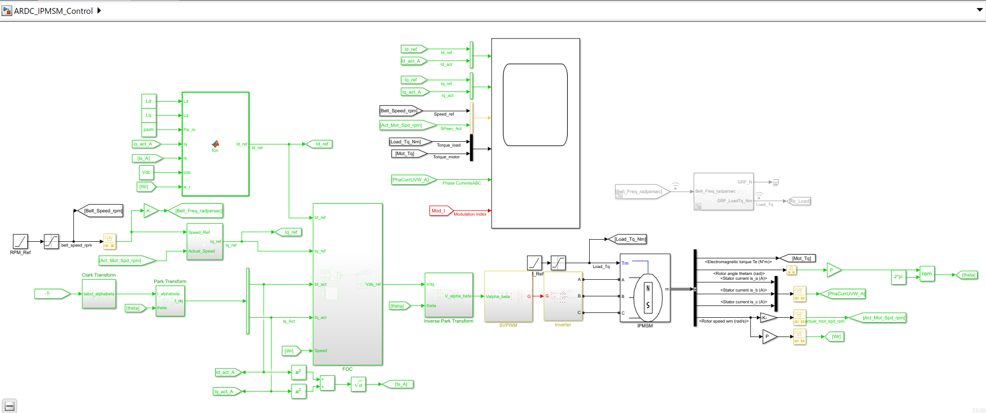
Simulation Layout

Slide 5
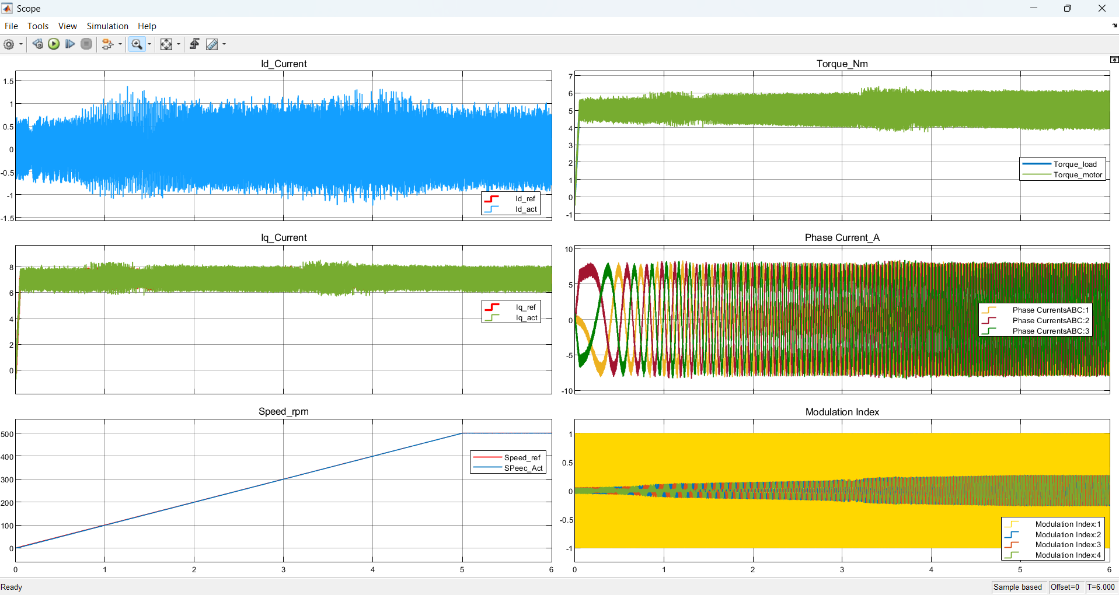
Simulation Results

Slide 6
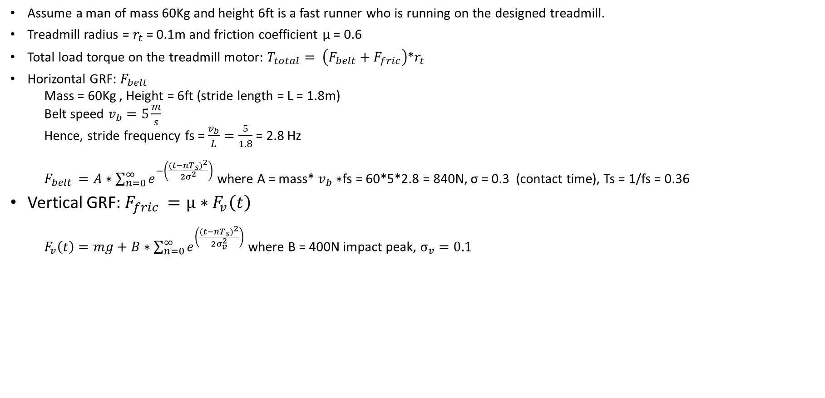
Treadmill Load Calculation
Assume a man of mass 60Kg and height 6ft is a fast runner who is running on the designed treadmill.
Treadmill radius = $r_{t}$ = 0.1m and friction coefficient µ = 0.6
Total load torque on the treadmill motor: $T_{total}= \left(F_{belt}+F_{fric}\right)$*$r_{t}$
Horizontal GRF: $F_{belt}$
  Mass = 60Kg , Height = 6ft (stride length = L = 1.8m)
  Belt speed $v_{b}=5\frac{m}{s}$
  Hence, stride frequency fs = $\frac{v_{b}}{L}=\frac{5}{1.8}$ = 2.8 Hz
  $F_{belt }=A∗\sum_{n=0}^{∞}{e^{−\left(\frac{{(t−nT_{s})}^{2}}{{2σ}^{2}}\right)}}$ where A = mass* $v_{b}∗$fs = 60*5*2.8 = 840N, σ = 0.3 (contact time), Ts = 1/fs = 0.36
Vertical GRF: $F_{fric }=µ∗F_{v}\left(t\right)$
  $F_{v}\left(t\right)=mg+B∗\sum_{n=0}^{∞}{e^{\left(\frac{{(t−nT_{s})}^{2}}{2σ_{v}^{2}}\right)}}$ where B = 400N impact peak, $σ_{v}=0.1$

Slide 7
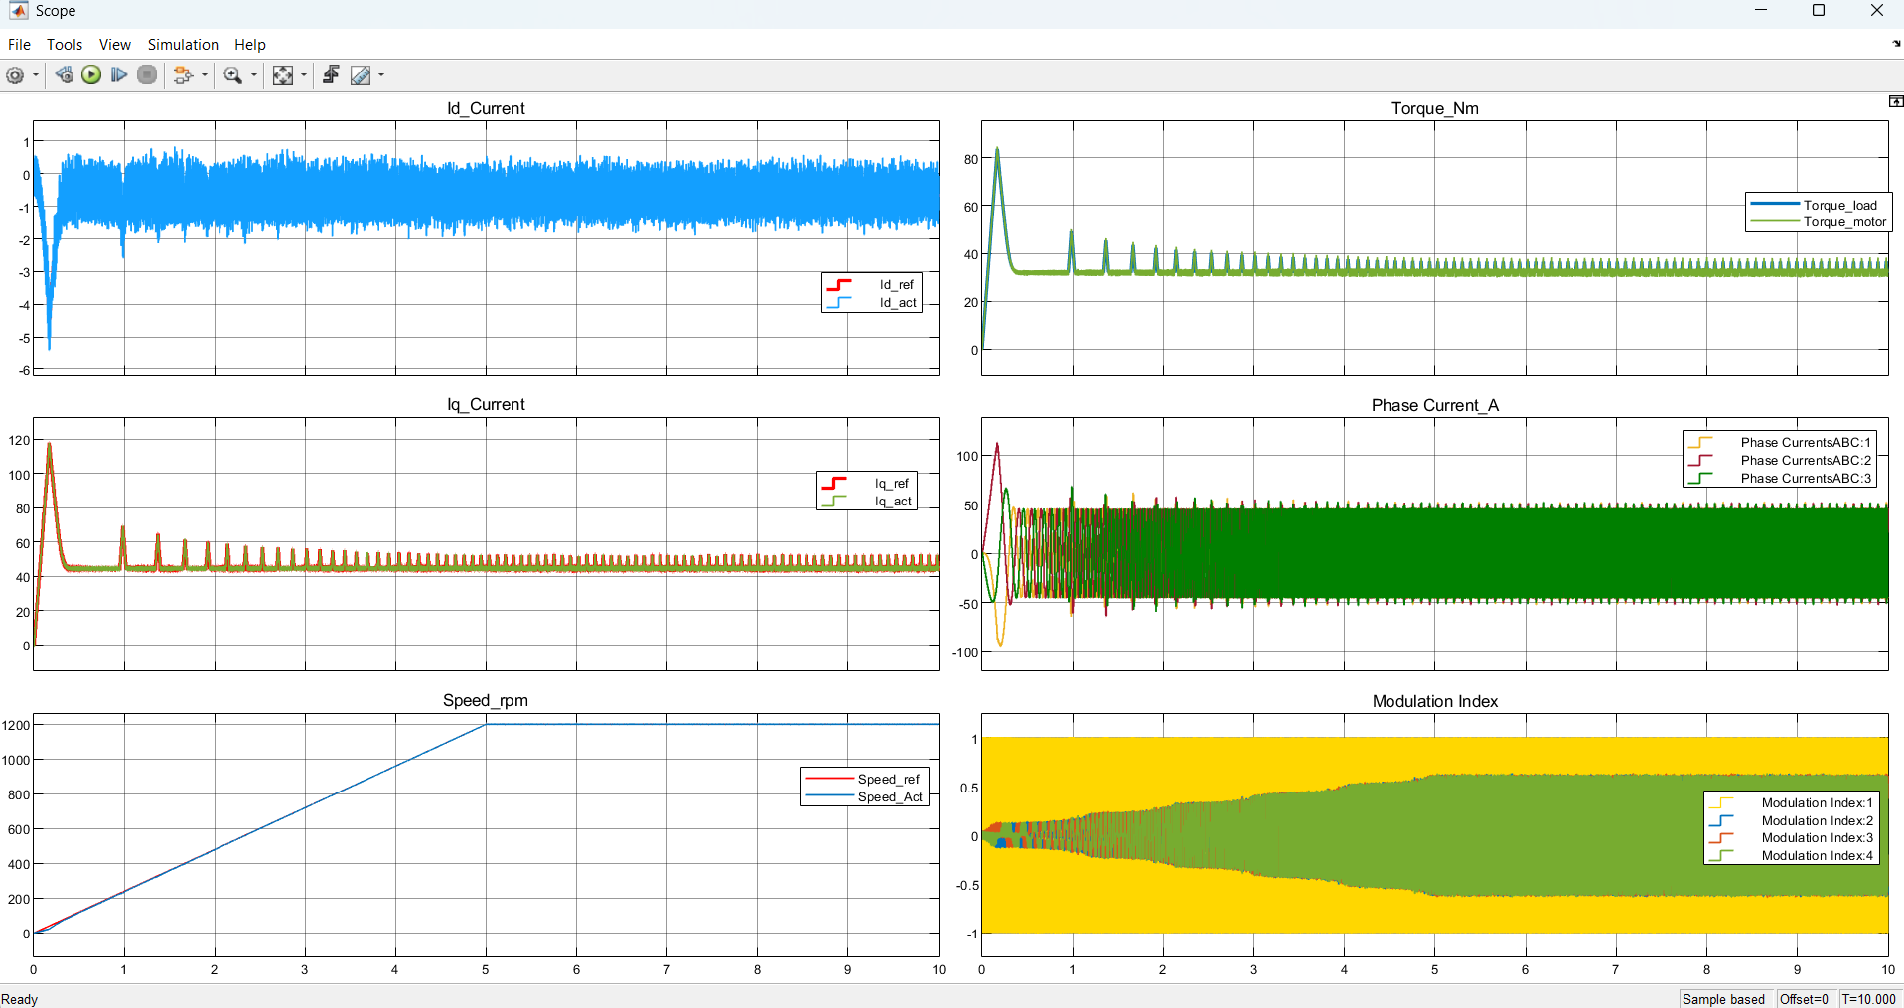
Basic FOC with Treadmill Load Results

